Slide 1
Unicorn Views predictor
Team members: Katherine Hsu, Maggie Chen, Patrick O’Brien, Sheerang Javadekar

Slide 2
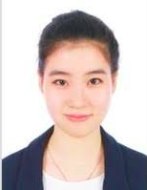
Self Introduction
Grew up in bay area 20 minutes from here
Masters student at the University of Pennsylvania

Slide 3
What is Unicorn Views Predictor?
Helps Youtubers decide next video’s topic!
User inputs text describing topic
Process Data
The Youtuber will enter our website to input text describing what topics he/she is considering next for a video. The user then clicks the “predict” button.
The text data is sent to the sequential neural network where it looks through videos of those topics to find out how many views they had and how many likes. It then outputs the predicted number of views and predicted number of likes
01
02
03
04
Mediator between frontend and Data
Data sent back to frontend
The backend created by my team member then takes the text data and sends it to be processed. This step is important for scalability.
The predicted number of likes and views is then sent through the Controller back to the website for display. The Youtuber will now decide if this is a good topic for the next video!

Slide 4
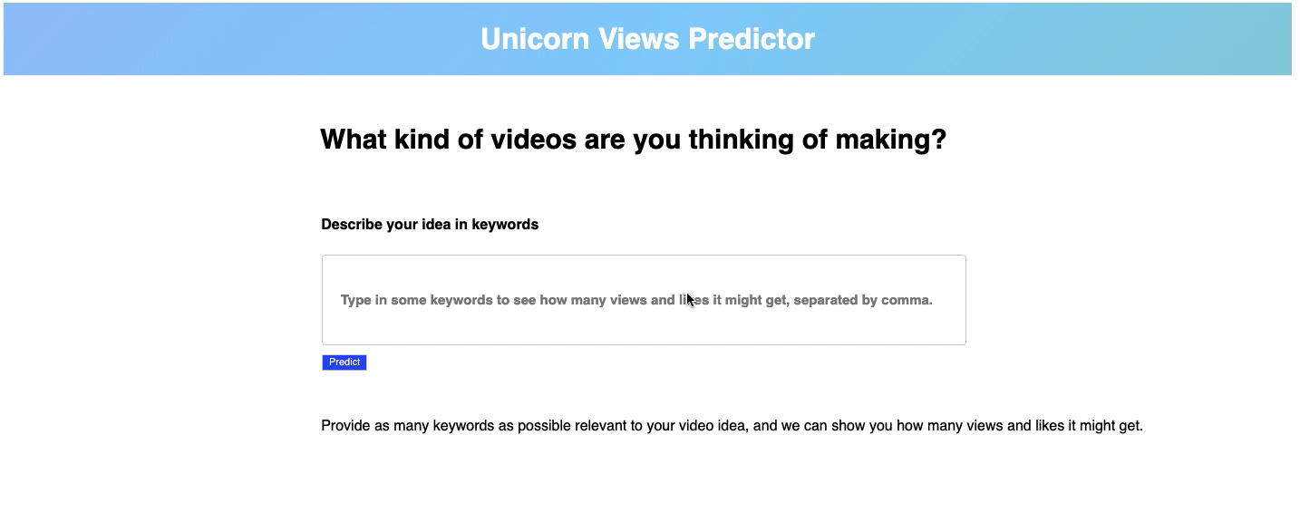
Demo

Slide 5
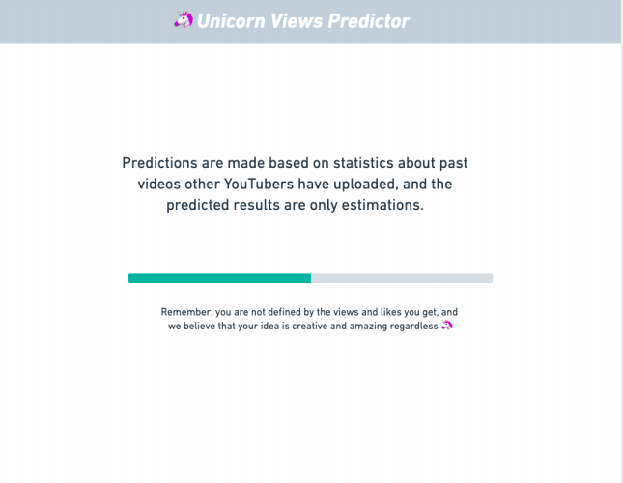
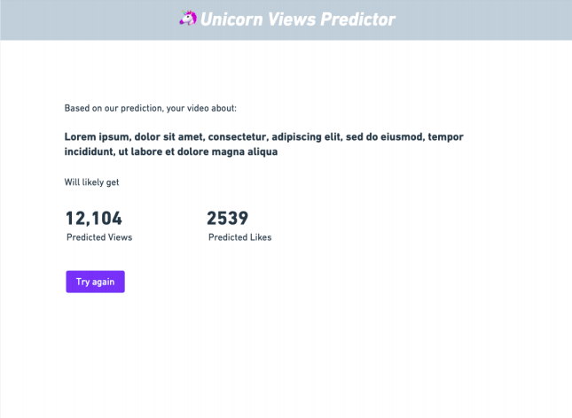
Next Steps

Slide 6
Project Continuation
What would I do if I have more time?
Transition Page with Animations
Process Bar/Transition Page
While the backend is processing the data, the user would see a bar displaying how much longer the YouTuber has to wait for results.
Connecting the frontend and backend
I would use Django to connect the backend and frontend so that the webpage can send the text data to the controller to send to the sequential neural network to predict the number of likes and views a video of these topics would have.
Displaying Results
Once the sequential neural network has processed the text data to decide what the predicted number of likes and views will be, it sends the data back to the webpage to display results for the user.
Connect Frontend and Backend
with Django
Display results for user to see

